Slide 1


SAP UI5 & FIORI with OData TRAINING
Anubhav Oberoy
Day – 10

Slide 2

Agenda – Day 10
Introduction to Runtime Artifacts
Implementing Get Entity and EntitySet Methods.
Introduction ot Postman Tool.

Slide 3
Runtime Artifacts
When we create a service there are 2 types of code which developer/system needs
Metadata code – which serve metadata of the service, will be generated by system automatically every time we change the service a new code will generate overwriting old code by SAP. This code is generated in MPC – model provider class
MPC = Model Provider Class (metadata) = where all the abap code will be generated which will have the code for metadata
Service Code – which is required as service implementation for performing CURDQ functionality. This code will be written by developer in a class called DPC = Data provider class.
DPC = Data Provider Class (data operations CRUDQ) = Contains all the implementation of CURDQ. It will get for each entityset 5 methods.
What if a developer need to customize the SAP generated code
SAP
Model provider class MPC class
Data Provider class
DPC class
Metadata
Types of entities
PROJ_SRV
Each entity 5 methods will be created –
OBJECT_GET_ENTITYSET
OBJECT_GET_ENTITY
OBJECT_CREATE_ENTITY
OBJECT_UPDATE_ENTITY
OBJECT_DELETE_ENTITY
MPC_EXT
Here we should write our code
DPC_EXT
CURD Functionality

Slide 4
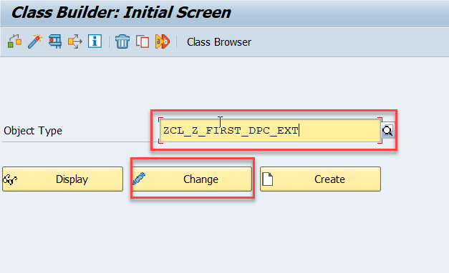
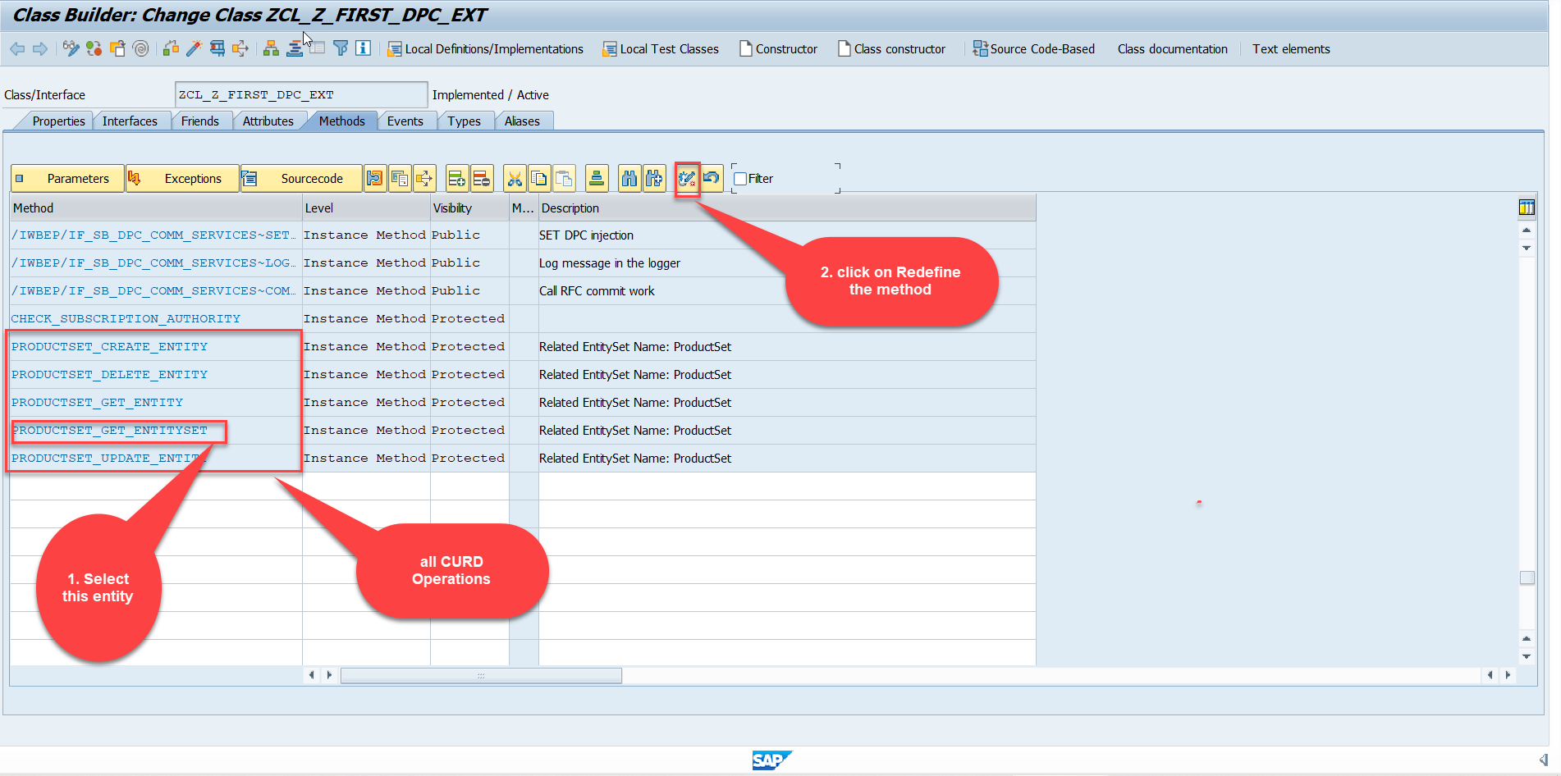
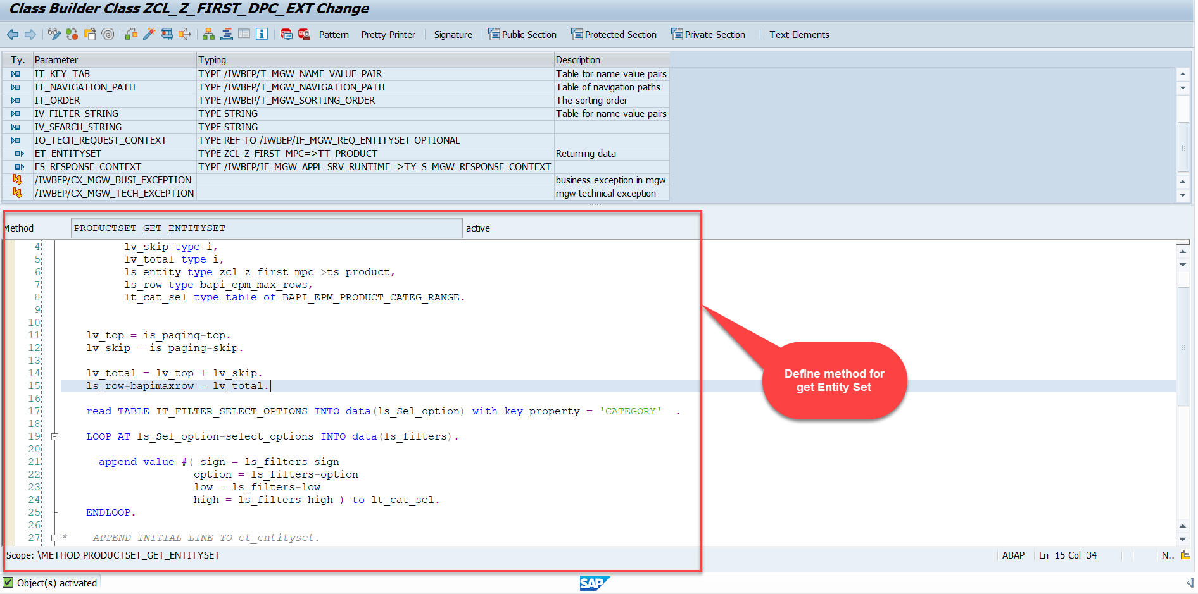
Building GetEntitySet Method
Step1: ProductSet Get Entity method(with filter, top and skip) in DPC Extension (Class Builder tcode- se24)

Slide 5
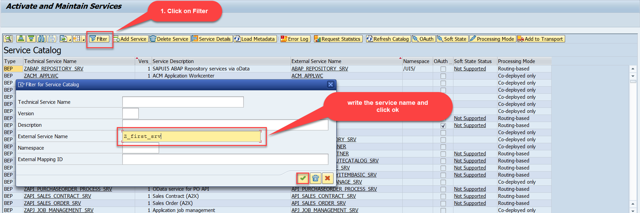
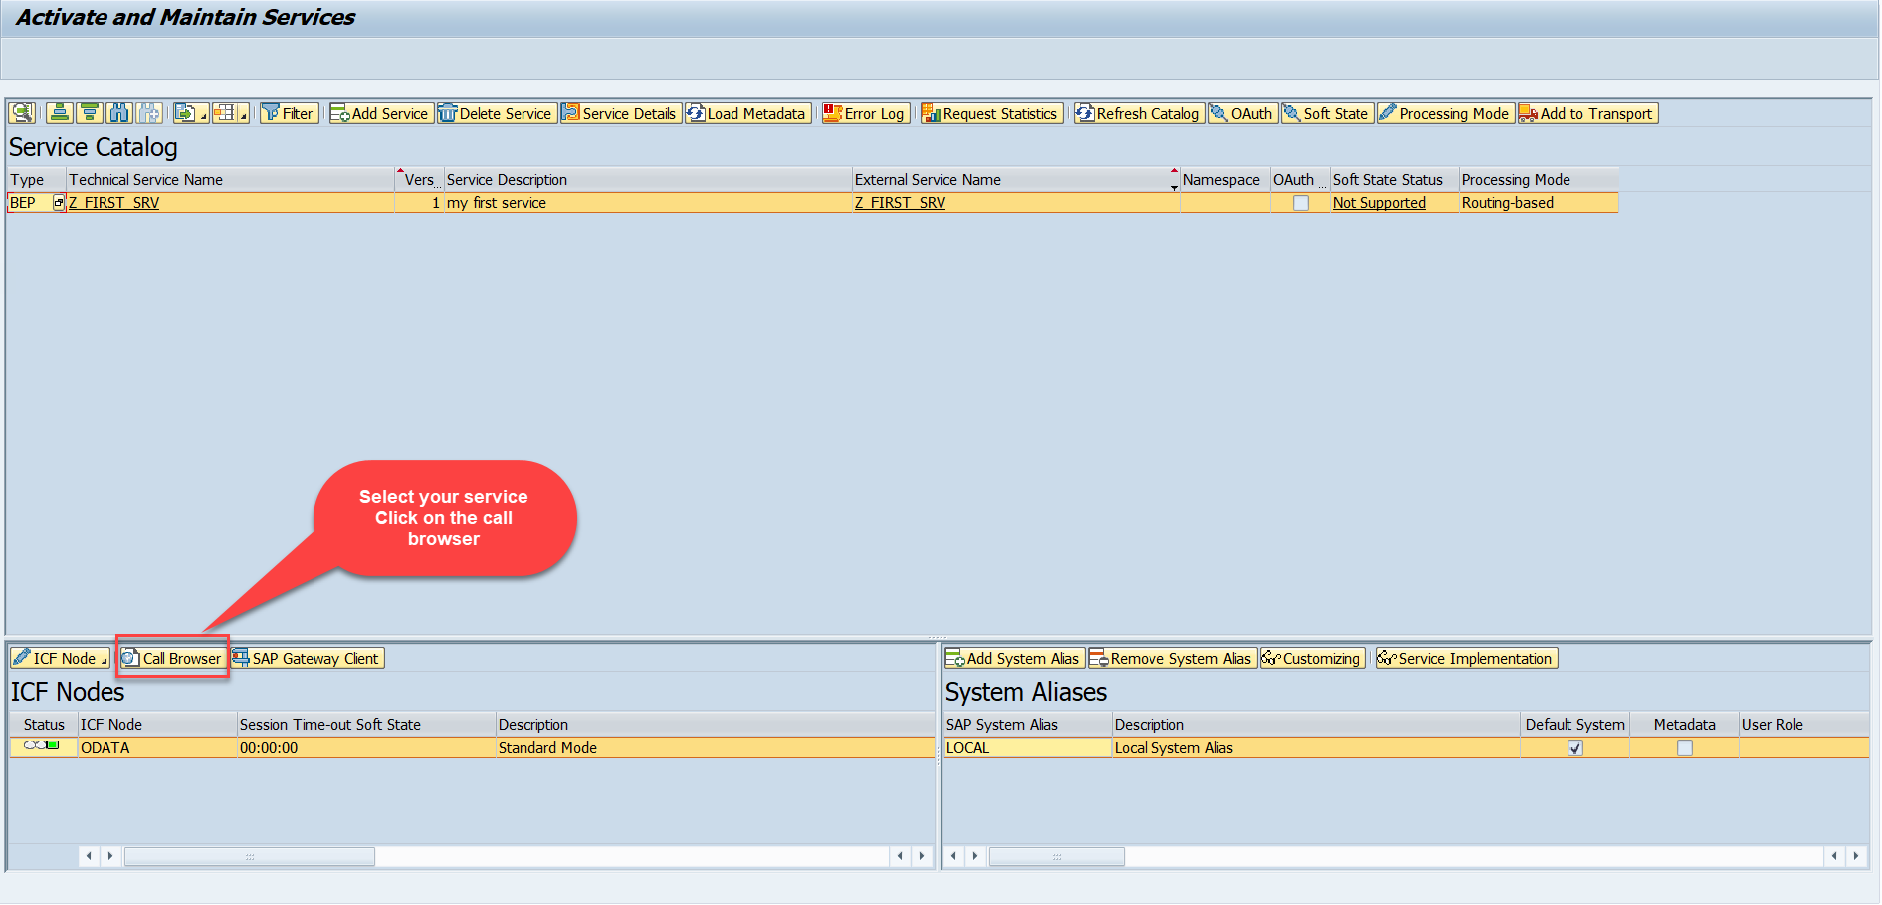
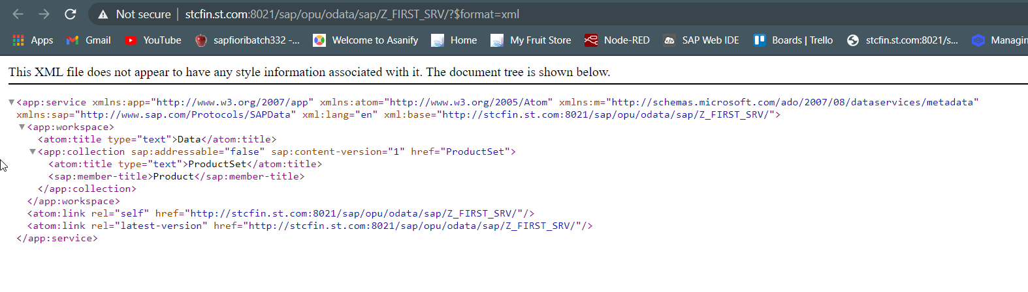
Building GetEntitySet Method Continue...
Step2: Call the service to the browser that we just created (go to service maintain (/iwfnd/maint_service))
Service in Browser

Slide 6
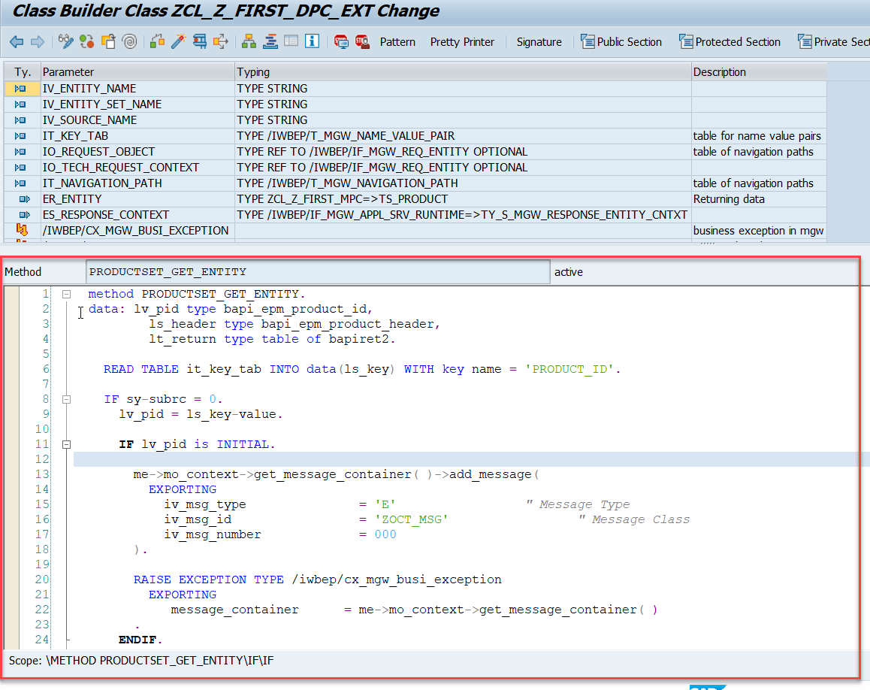
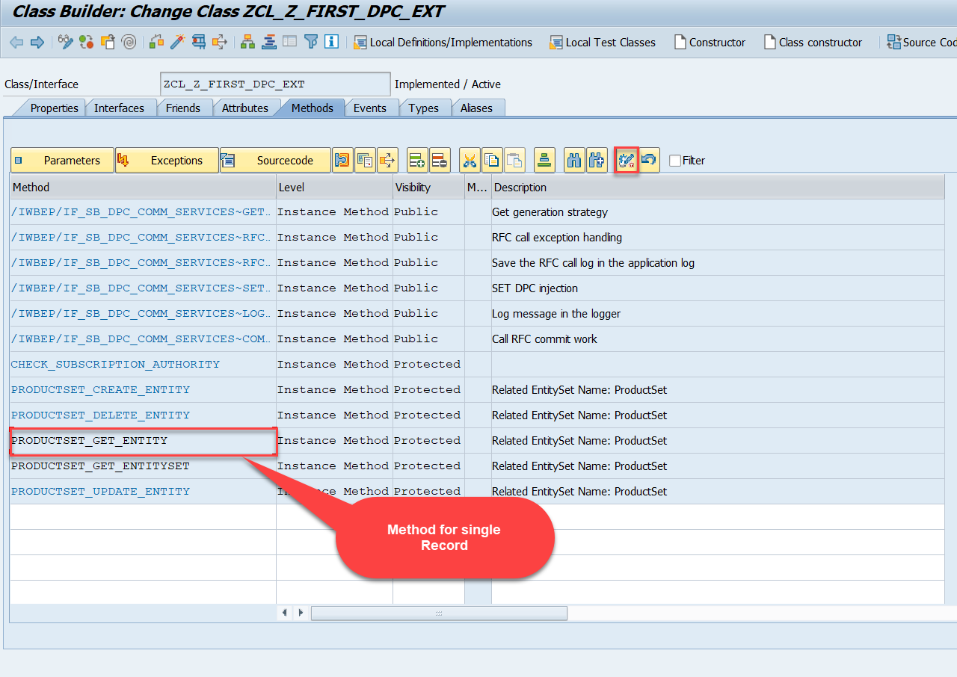
Building GetEntitySet Method Continue...
Go to DPC Extension of over service and redefine the method PRODUCTSET_GET_ENTITY

Slide 7
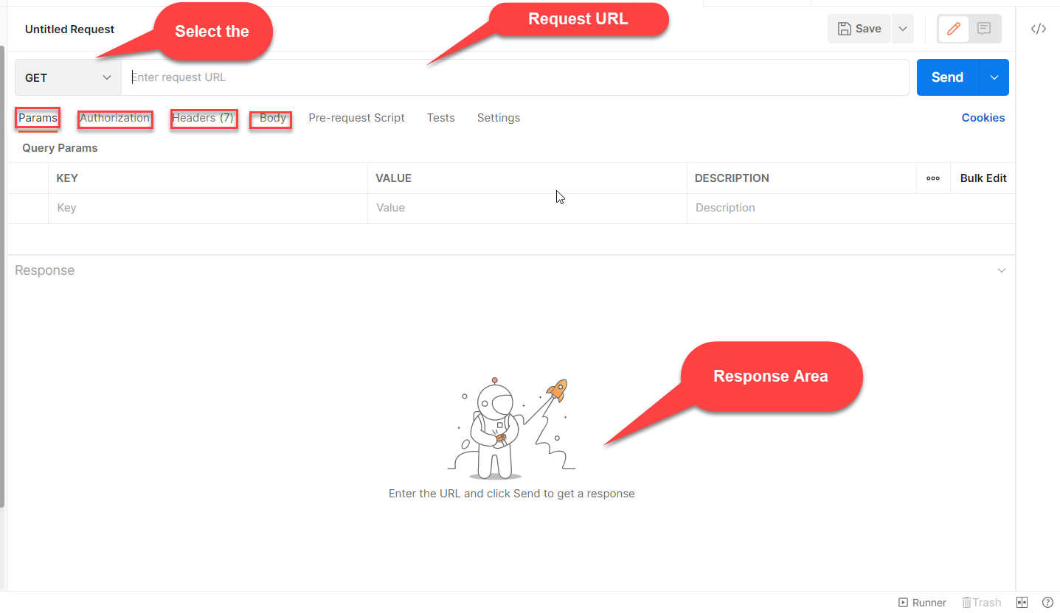

Postman
Postman is a free tool which can be used to test any kind of REST/OData Services outside of the system. This allows us to consume the data as if an external consumer would really do.
Postman is an API platform for building and using APIs. Postman simplifies each step of the API lifecycle and streamlines collaboration so you can create better APIs—faster.
As an ABAP developer, you can develop postman collection and deliver it to Fiori Developers for consumption to showcase, what our service is capable of.

Slide 8
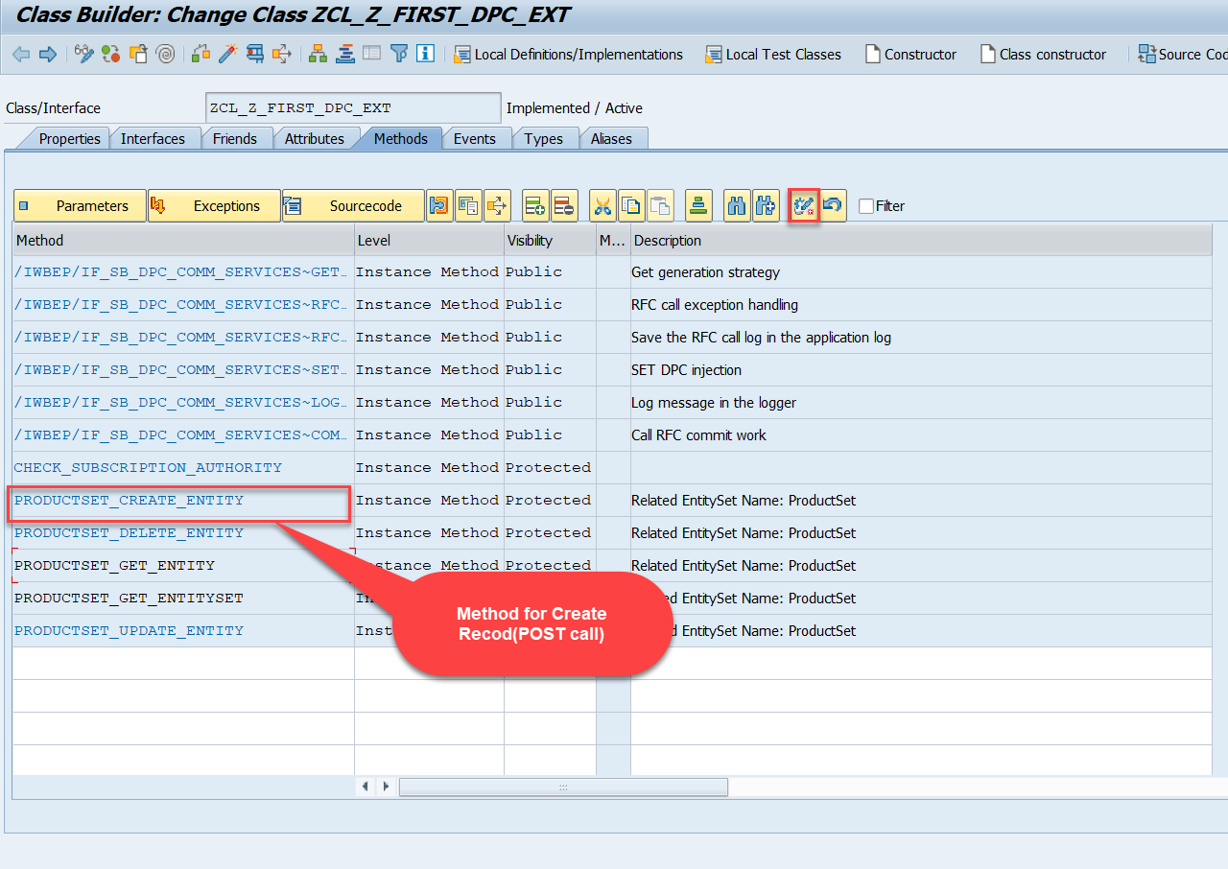
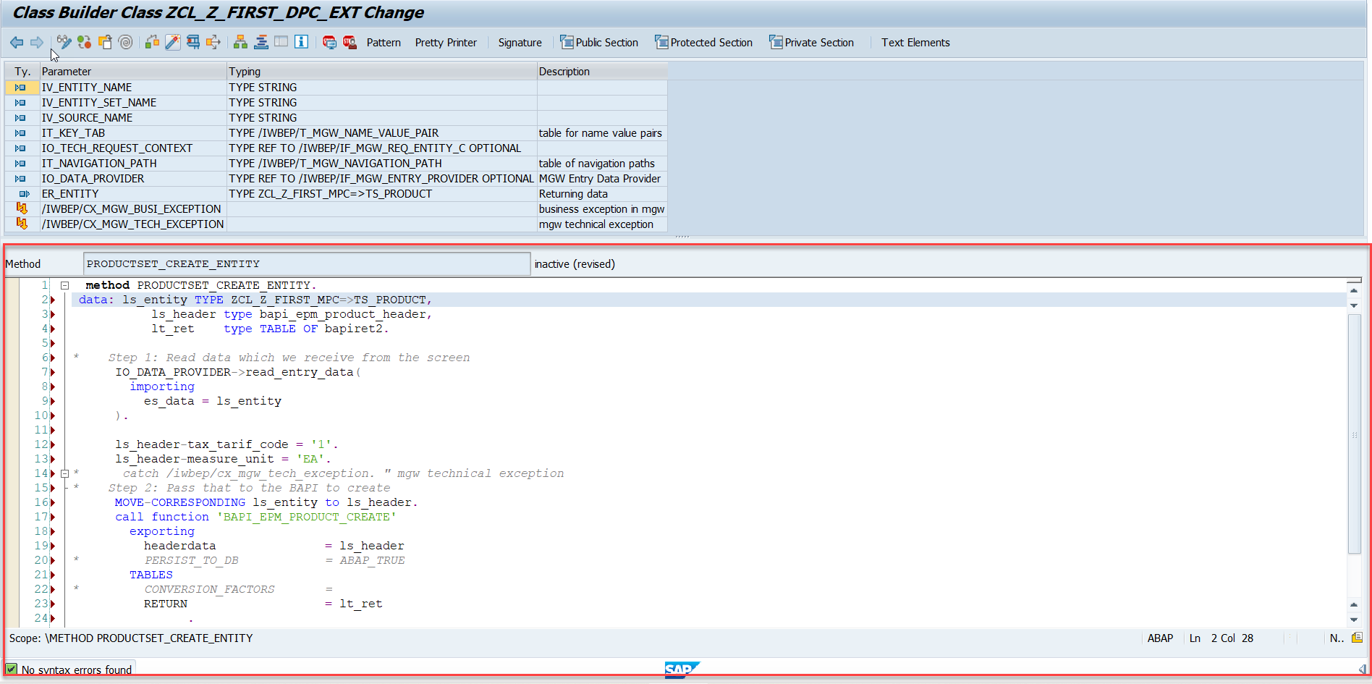
Building CreateEntity(POST) Method
Go to DPC Extension of over service and redefine the method PRODUCTSET_CREATE_ENTITY
Code: CreateProductEntity

Slide 9
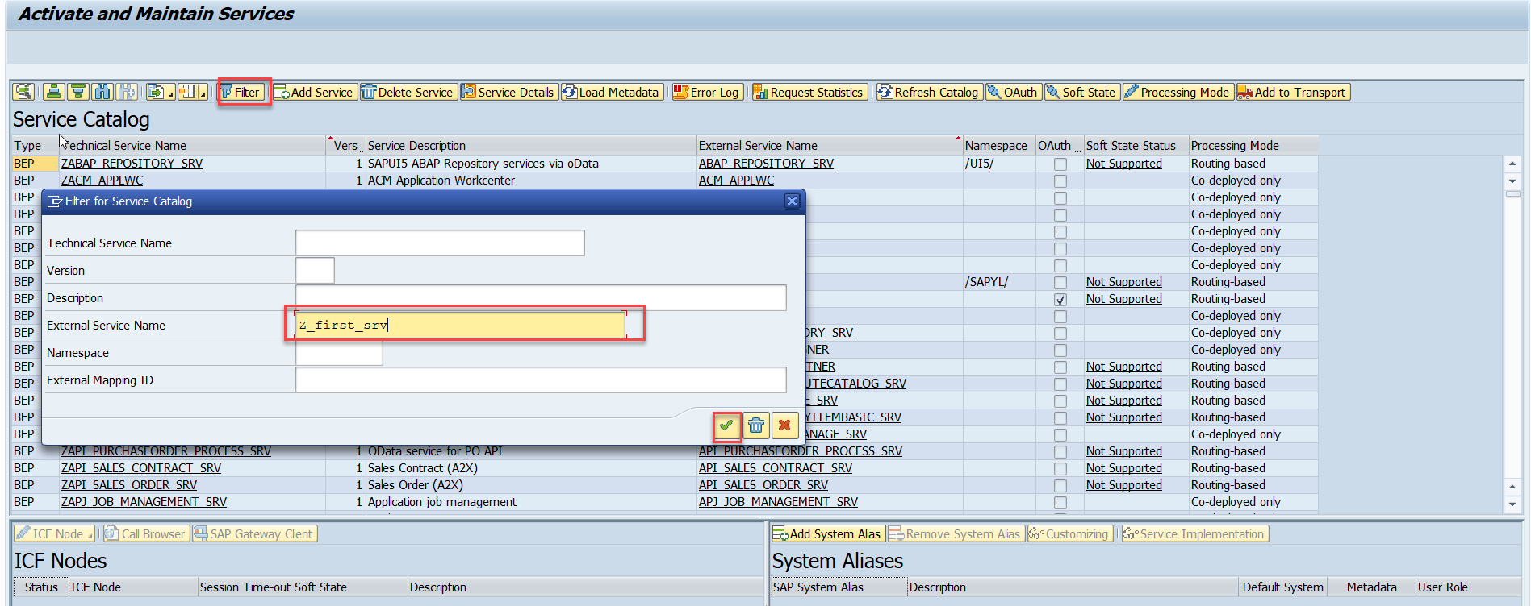
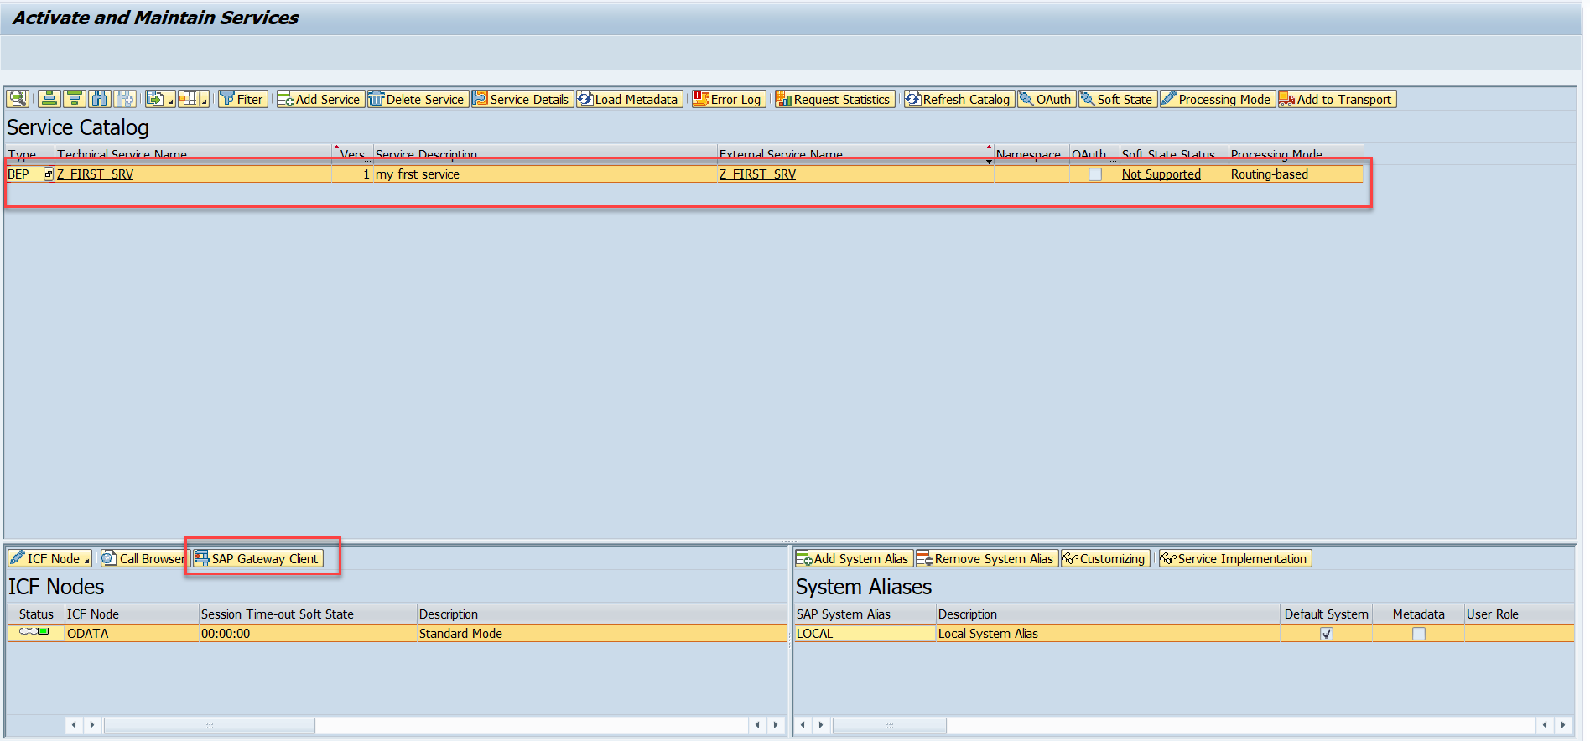
Testing Create Method at Sap Gateway client
Step:1 Go to sap service maintance(tcode- /iwfnd/maint_service) and search for the service and then select the service and click on the sap gateway client

Slide 10
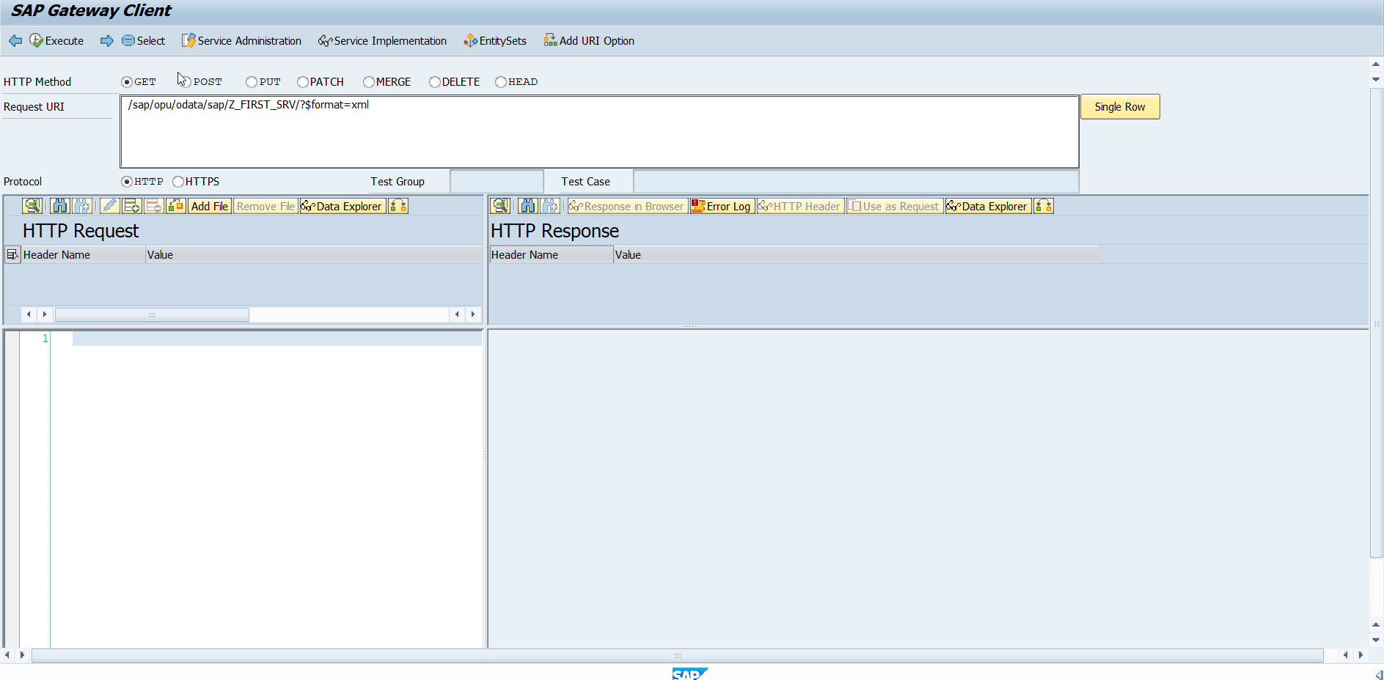
Testing Create Method Continue…
Step:2 Go to sap service maintance(tcode- /iwfnd/maint_service) and search for the service and then select the service and click on the sap gateway client

Slide 11
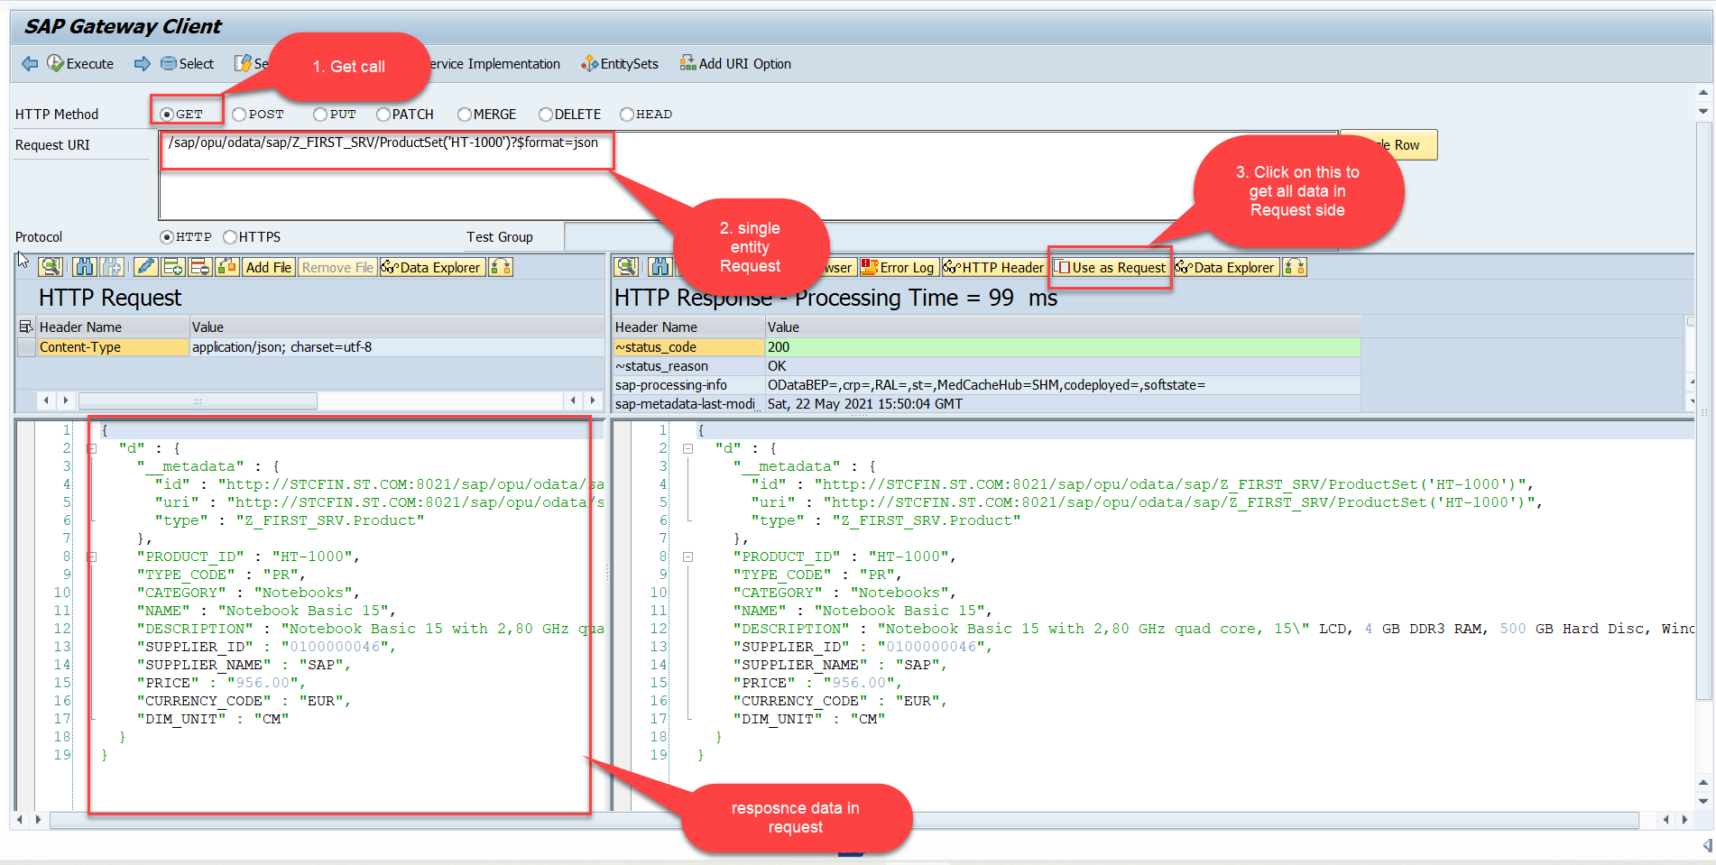
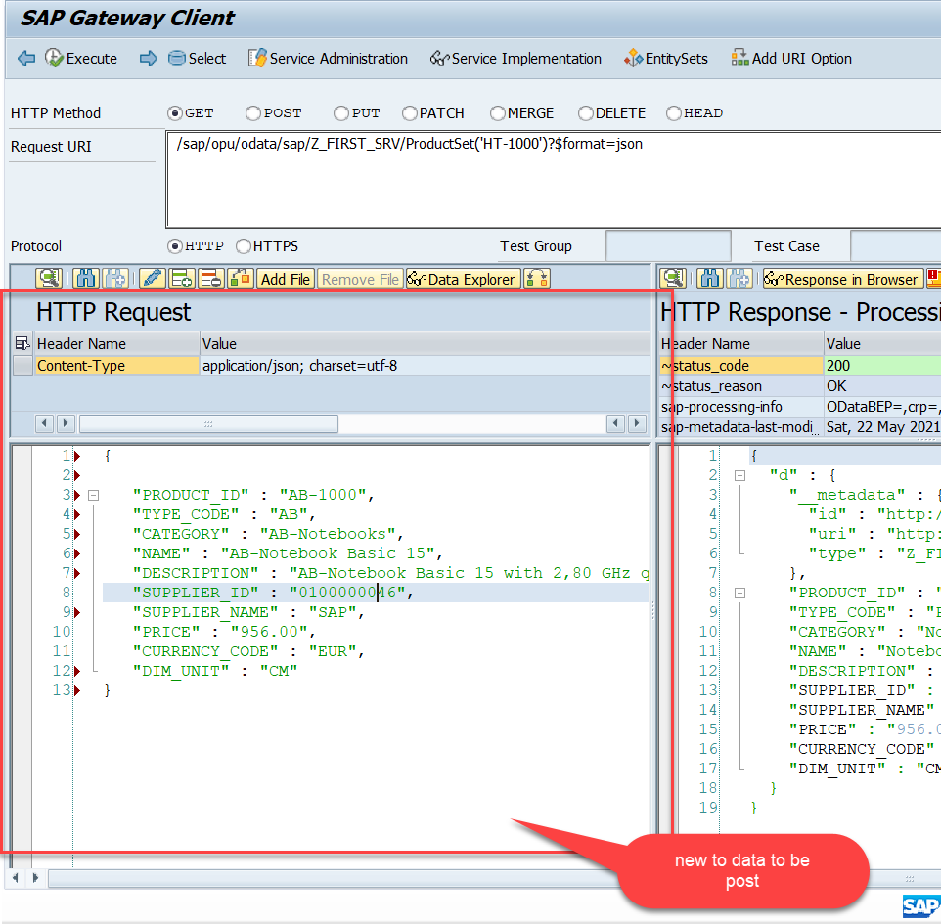
Testing Create Method Continue…
Step:3 Perform a getEntity in the Product set to get the payload to post (/sap/opu/odata/sap/Z_FIRST_SRV/ProductSet('HT-1000')?$format=json) and then clean the data and modify the payload as new.

Slide 12
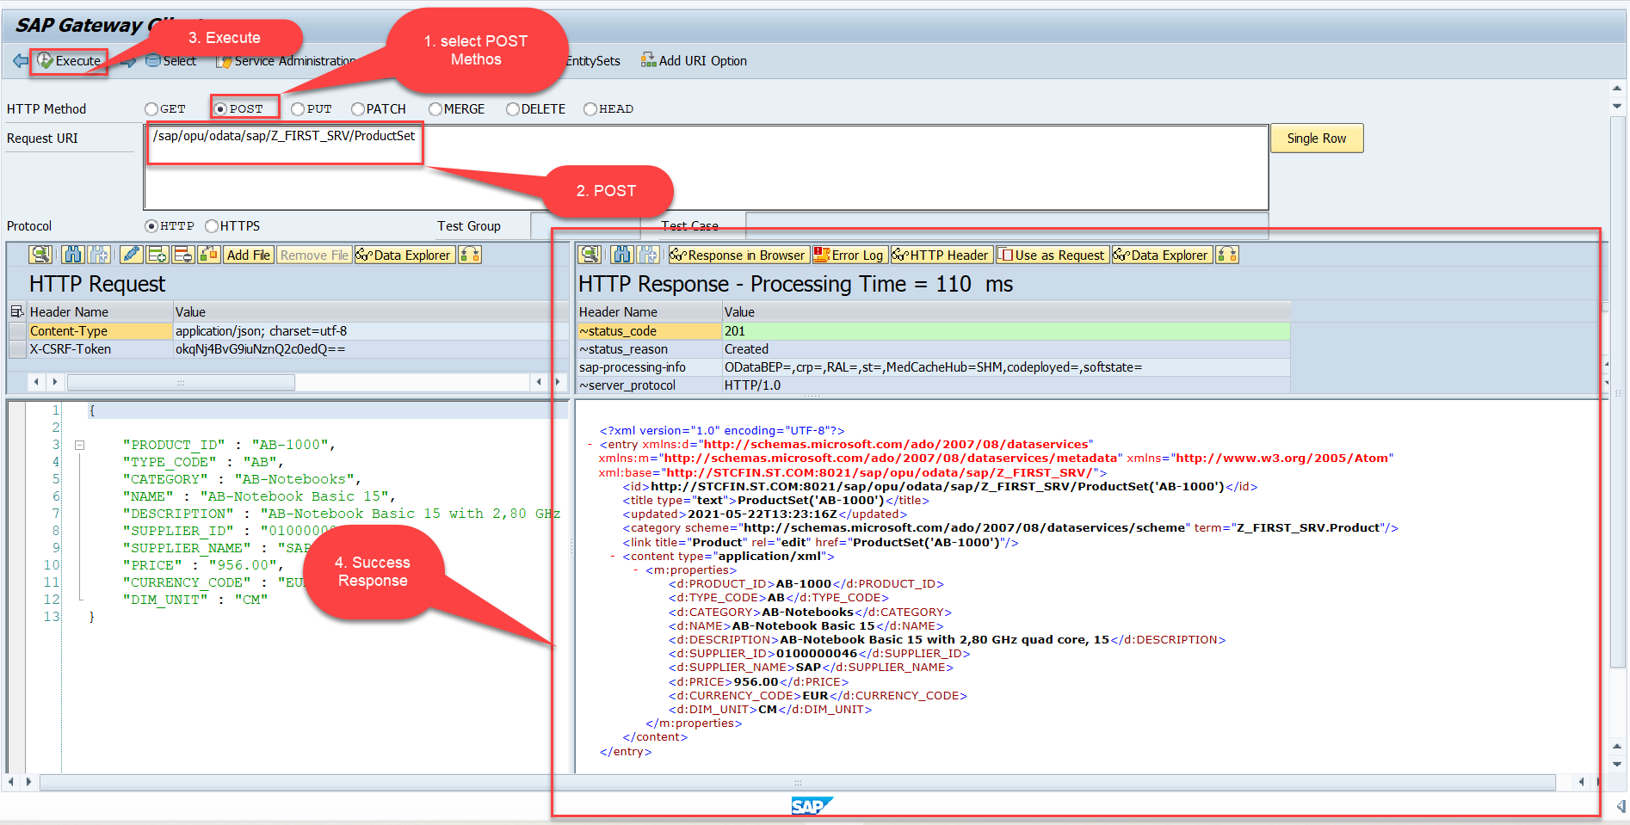
Testing Create Method Continue…
Step:4 send the post request at (/sap/opu/odata/sap/Z_FIRST_SRV/ProductSet)

Slide 13
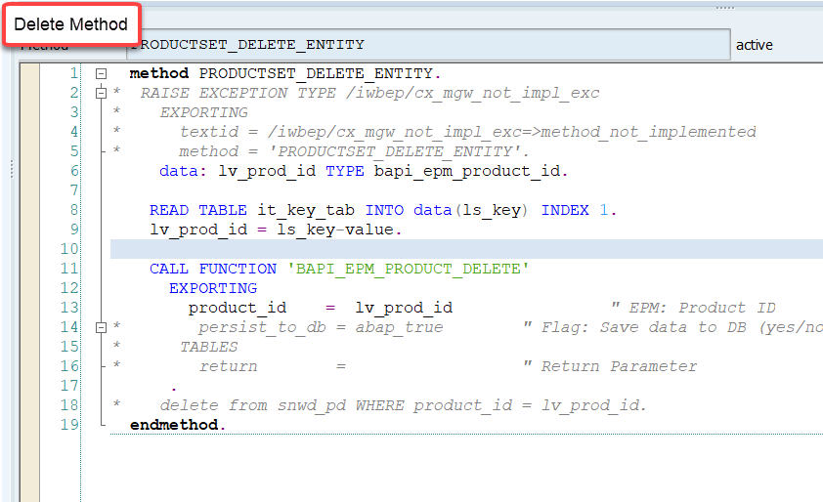
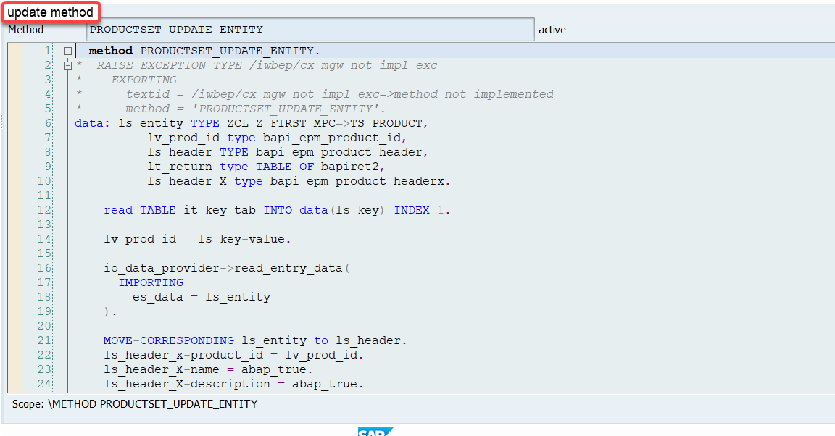
Implementing DELETE and Update (PUT) method
We can implement the delete and update method in the corresponding DPC extension classes.
Code: ProductSetDeleteEntity
Code: ProductSetUpdateEntity

Slide 14
Introduction to POSTMAN Tool
Postman is an API platform for building and using APIs. Postman simplifies each step of the API lifecycle and streamlines collaboration so you can create better APIs—faster.
It is an interactive and automatic tool for verifying the APIs of your project.
It presents you with a friendly GUI for constructing requests and reading responses. ... Postman is the way to streamline the process of API testing.
Postman can run GET, POST, PUT, PATCH, MERGE, DELETE, and various other request methods as well, and has utilities to help with developing APIs. Free and paid versions are available for Mac, Windows, Linux, and as a Chrome app.
You can Download the postman tool from the link give below:
https://www.postman.com/downloads/

Slide 15
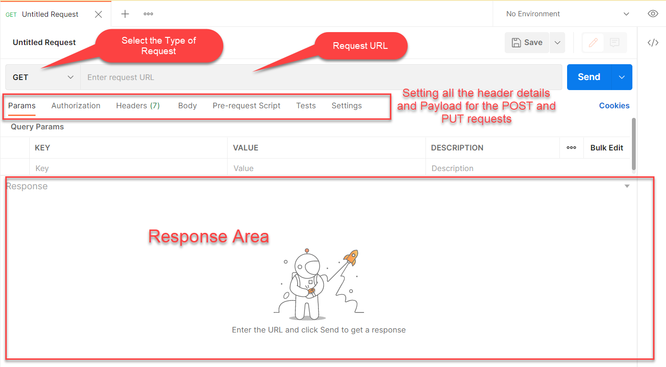
Postman App Layout
The below screen shot shows a basic layout of a request in Postman

Slide 16
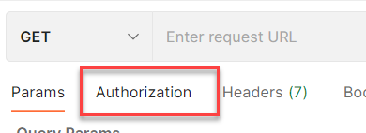
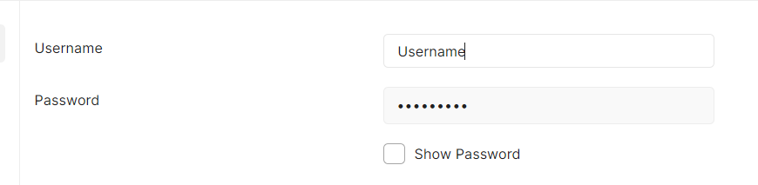
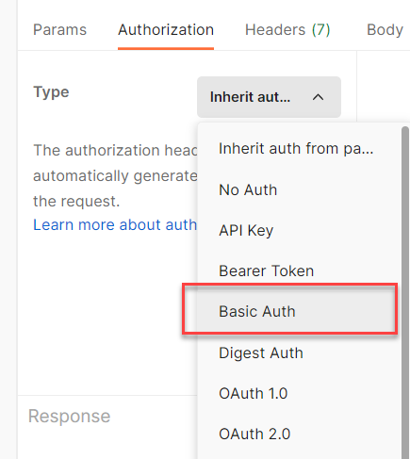
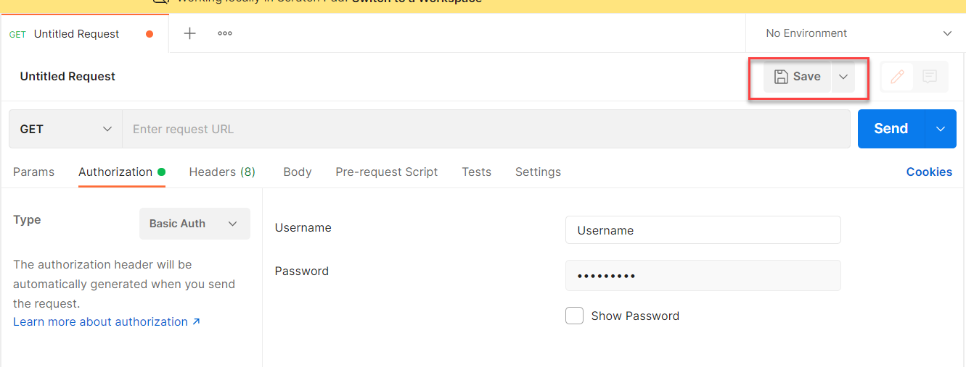
Setting Basic Auth in Postman
Step 1: Go to the Authorization section.
Step 3: Set the Username and Password.
Step 2: Select Basic Auth as Type
Step 4: Save.

Slide 17
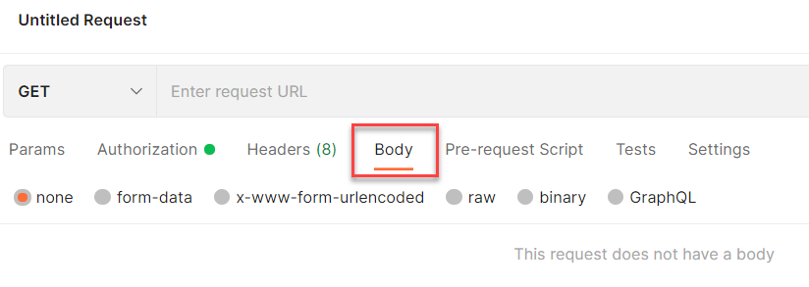
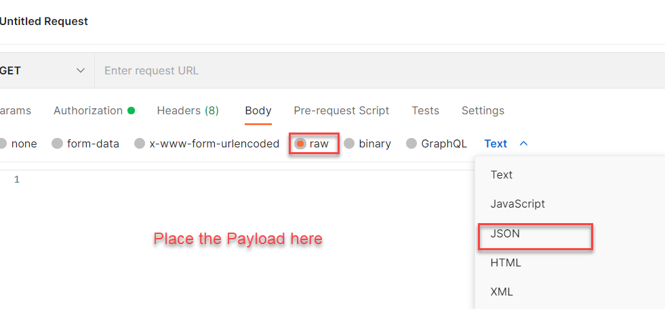
Setting the Payload for POST and PUT request
Step 1: Go to Body Section.
Step 2: Select the raw option form the radio button and then select the data type as JSON.

Slide 18
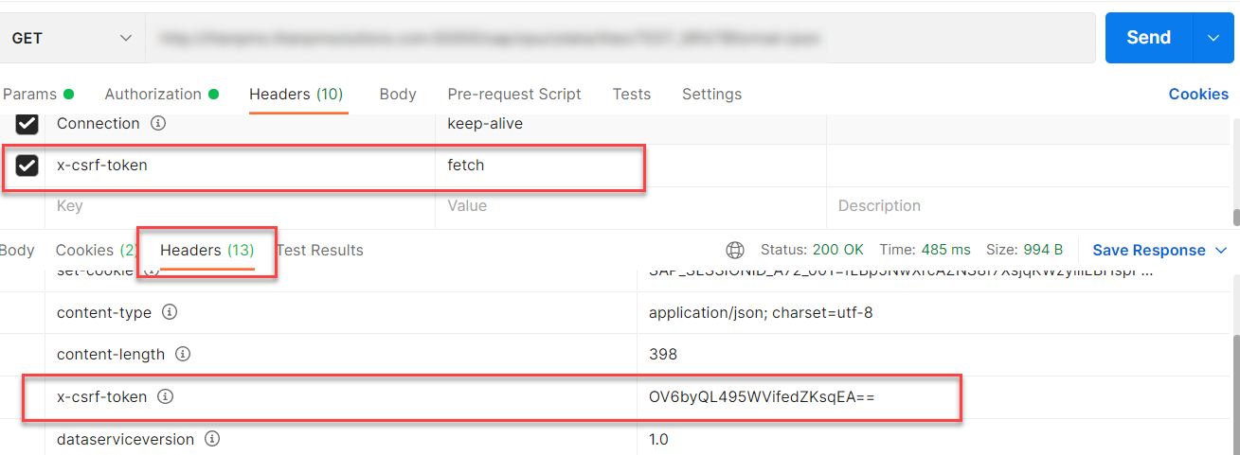
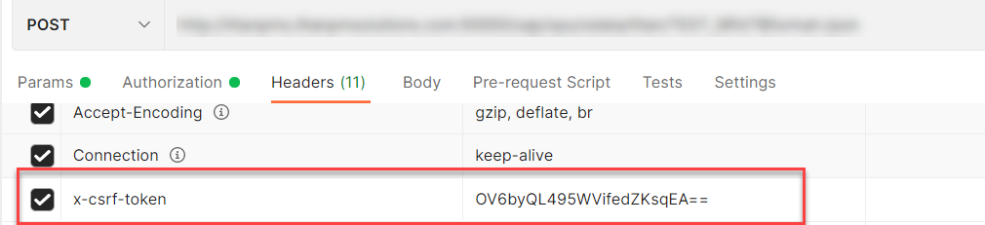
X-CSRF Token
A CSRF Token is a secret, unique and unpredictable value a server-side application generates in order to protect CSRF vulnerable resources.
The tokens are generated and submitted by the server-side application in a subsequent HTTP request made by the client.
Steps to Get the x-csrf token.
To get the x-csrf token we need to pass the value of x-csrf token as fetch with the GET call.
After executing the get call we will find the token in the Header Section of the Response.
- In POST call we need to pass this value of x-csrf token in the header section.

Slide 19
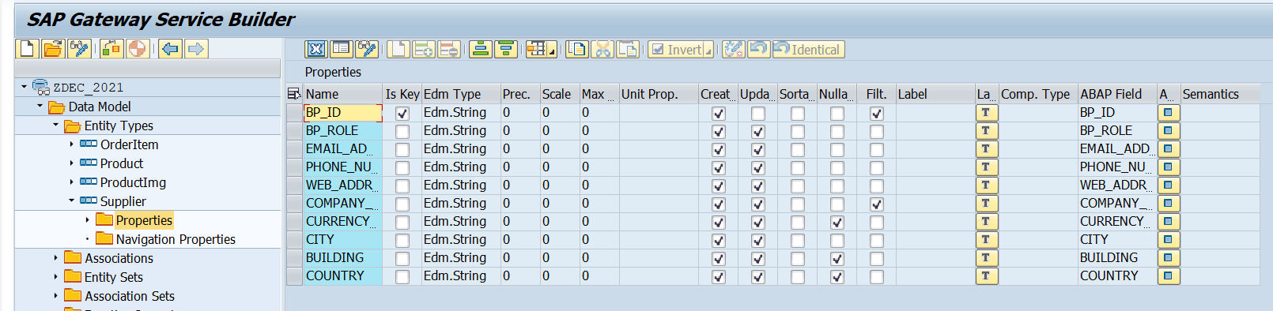
Create Supplier Set
Create a Supplier Set in the Entity Type Section by following the steps used to create Product Set.
Supplier Set
Once the Entity sets are created, we can also implement the Get Entity for of Supplier Set in the same way as we have created for the Product Set.
Code to Create Supplier Set Get Entity
SupplierSetGetEntity

Slide 20
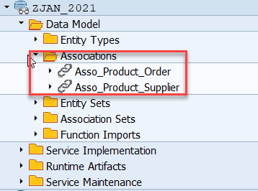
Association
Associations are relationship Between entities.
At database level we have foreign key relationship and same is reflected at odata level.
Once a association is created only then we can create navigation property.
Product
Supplier
1 relation 1
nav

Slide 21
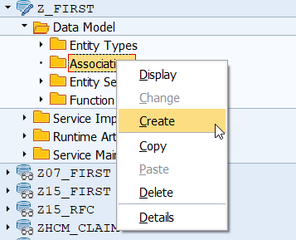
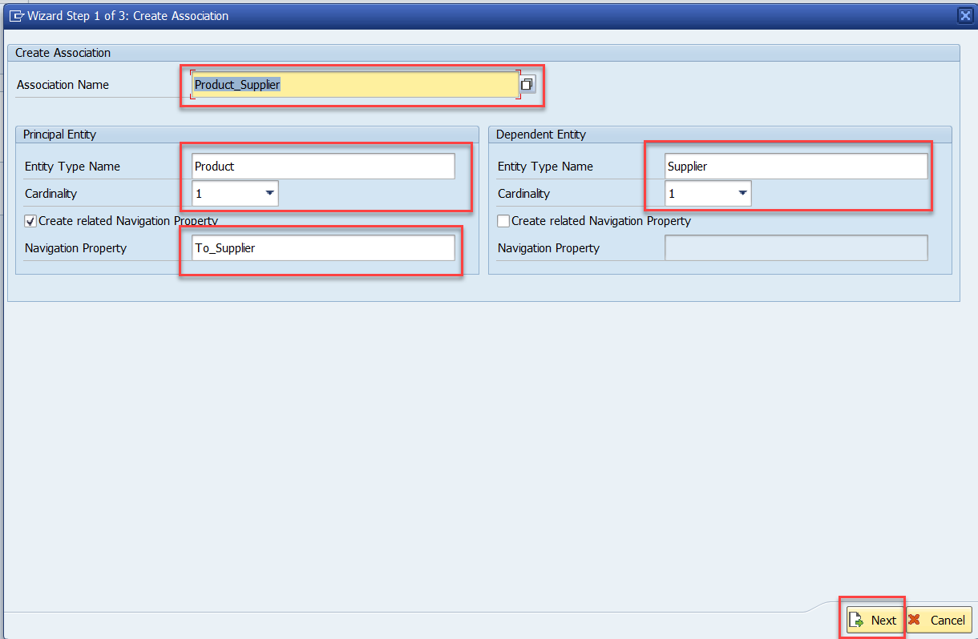
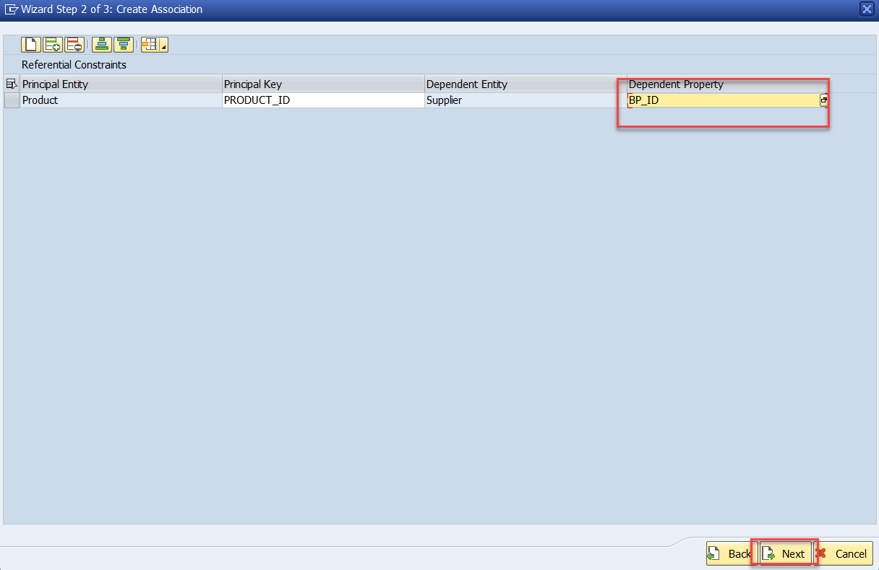
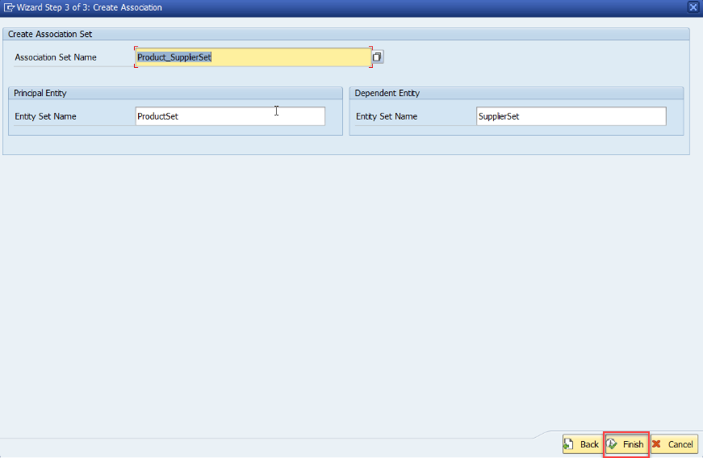
Association (1:1)
Step:1 Right Click on Association and click on create
After creating the Association for Supplier Set in Product Set, we need to change the Supplier Get entity.
SUPPLIER_GET_ENTITY (Association)

Slide 22
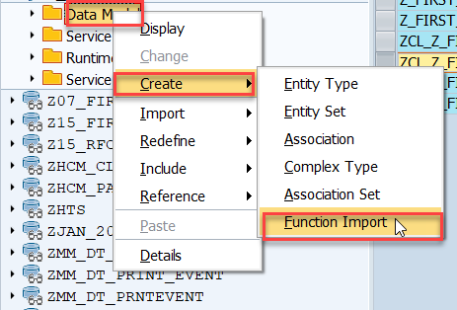
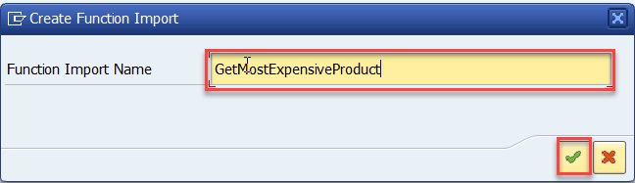
Function Import
At times, we need to implement the logic inside of OData which is not a direct CRUD operation e.g. calling a workflow, calling a BAPI which does some processing, Sending request to another server and can be invoked by the HTTP methods GET or POST .
For example: we can create the function import to GetMostExpensiveProduct in our Product set by the Category.
Step1: Right click the Data Model folder and select Create and then select Function Import. Create Function Import dialog opens

Slide 23
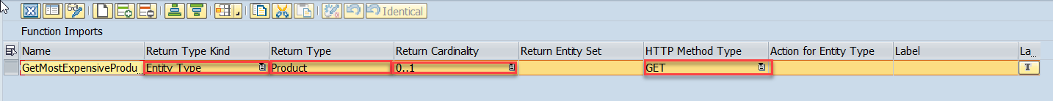
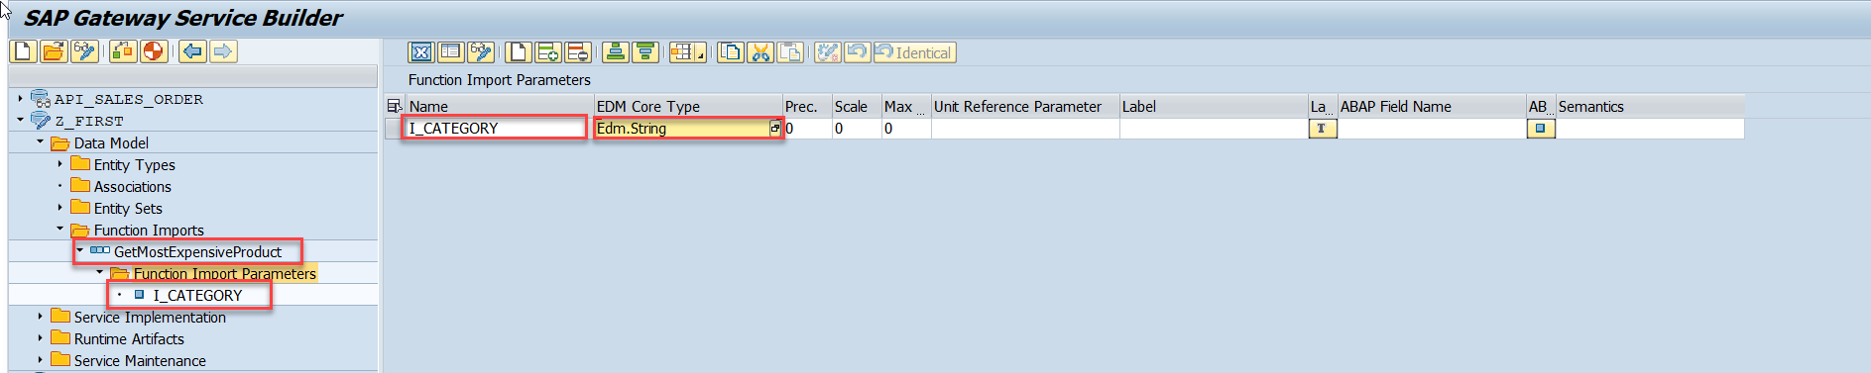
Function Import
Step2: Enter return type kind, return type, return cardinality & HTTP method Type
Step3: Giving function import parameters (I_CATEGORY)

Slide 24
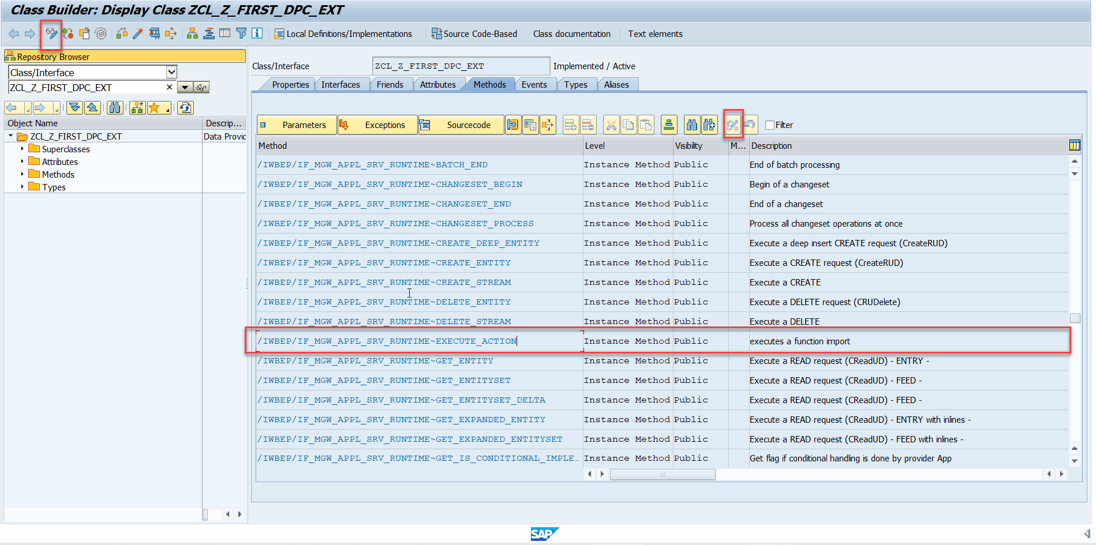
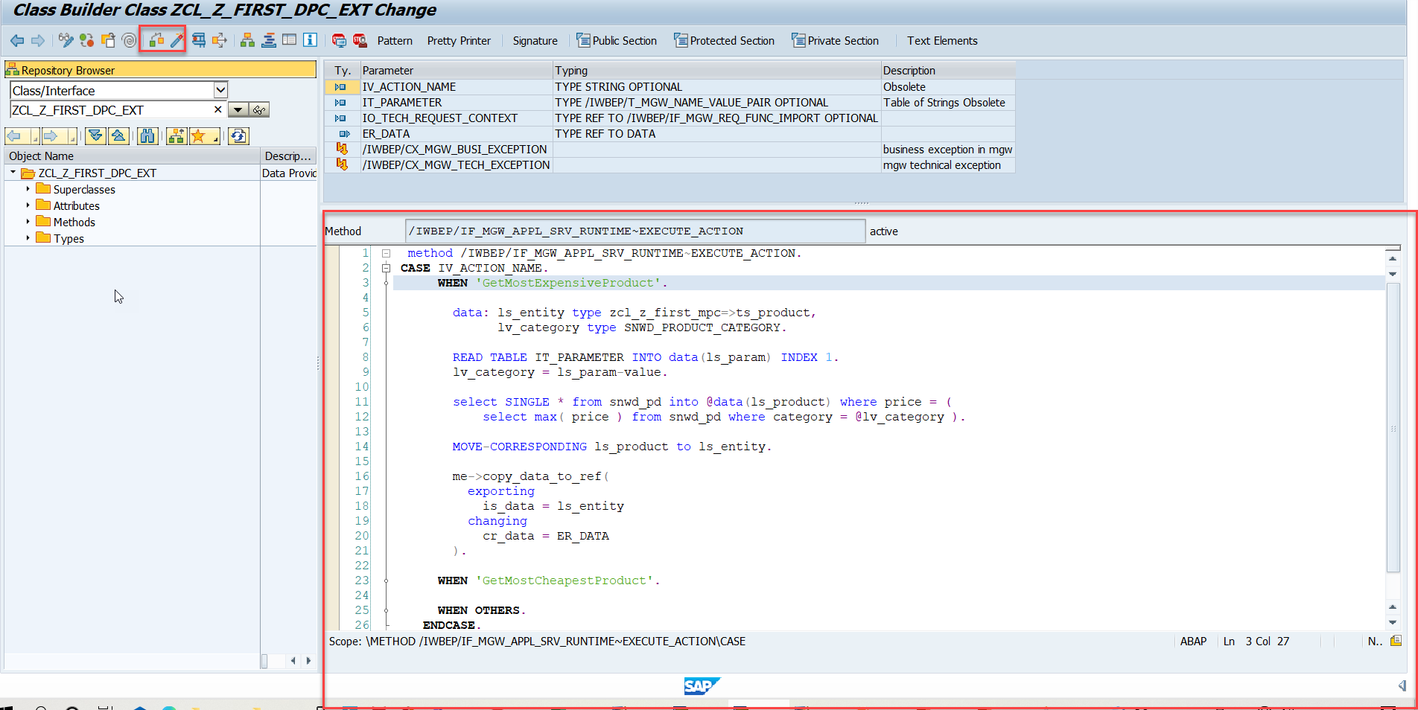
Function Import
Step4: Go to DPC Extension and search for the method--/IWBEP/IF_MGW_APPL_SRV_RUNTIME~EXECUTE_ACTION and redefine the class method
Function Import Code: funciton_import

Slide 25

End of Day 10

Slide 26

Questions

Slide 27

Anubhav Oberoy

Slide 28


We’re committed to empower you to be
Most Desirable Resource
through powerful training solutions.
We build the workforce of the future.
250+
Corporate Clients
30,000+
Learners Trained
25000+
Learners Placed
FREE WEBINARS
Sign up for free webinars with industry experts every fortnight!
Enroll Now!
Contact us today!
https://anubhavtrainings.com/

Slide 29




More from AnubhavTrainings.com

Slide 30
Title
Content

